Slide 1
Notes:
<Set Skype to Do Not Disturb>
<Start transcription>
<Prep Otter.ai transcription link>
<Watch for access issues in RT and email>
<Start recording>
Hello everyone, I’m Nicole Swanson at CARLI, the Consortium of Academic and Research Libraries in Illinois,
and I’m pleased to welcome you today to this Professional Development Alliance program, The ACRL Academic Library Trends and Statistics Survey, generously presented by Devin Savage, Janine A. Kuntz, and Jeannette E. Pierce.
Just a few quick housekeeping items:
Please ensure your microphone is muted.
Near the end of the session, you will have an opportunity to ask questions via the chat box or by unmuting your microphone.
If you are unmuting, please also share your video if you can <to help those of us who benefit from lip reading>.
An Otter.ai transcription is enabled for this workshop. You can access it near the top of the Zoom window from the dropdown menu. Also, I’ll add the transcription link to the chat shortly.
This program is being recorded and the recording will be shared afterwards.
At this time, it is my great pleasure to welcome our esteemed speakers who will be sharing with us more about themselves!
<stop screenshare>
<speakers introduce themselves>
Devin Savage is the Dean of Libraries for the Illinois Institute of Technology, where he has served previously in a variety of management and leadership roles over the last eight years. Prior to his work at Illinois Institute of Technology, he also served in a variety of roles in his 15 years at Northwestern University Library, including Assessment Librarian. Among his other current professional service and contributions, Savage currently serves as the Chair of the ACRL Academic Library Statistics and Trends Editorial Board.
Janine A. Kuntz (she/her) is the Instruction & Social Sciences Librarian at Wheaton College MA. She holds an MLIS from San Jose State University, a BS in Sociology with a WGS minor and a BA in English Literature both from North Dakota State University. Janine has been active in ALA and ACRL for a number of years, currently serving as a member of the ACRL Academic Library Trends and Statistics Survey Editorial Board, and previously serving on committees within WGSS and LIRT. Her professional interests include assessment, critical pedagogy, and information/digital literacies.
Jeannette E. Pierce is Associate University Librarian for Research, Access, and Instructional Services and Interim Associate University Librarian for University Archives, Special Collections, and Digital Services at the University of Missouri-Columbia. Jeannette served previously at Loyola University Chicago, first as head of reference services and subsequently as director of the Loyola Information Commons, an innovative four-story addition to the main library managed in partnership with campus technology services and focused on student success. Early career positions included librarian positions at Johns Hopkins University and Saint Louis University. Jeannette is an active member of numerous professional organizations, including the Association of College and Research Libraries (ACRL), with a consistent history of active service and leadership. Jeannette holds an MS degree in Library and Information Science and a BA in History from the University of Illinois at Urbana-Champaign, and an MS in History from Saint Louis University. Jeannette is a recent alumnus of the Association of Research Libraries’ Leadership Fellows Program.
<Session>
<CARLI Staff: assist in watching for questions?>
<Thank yous> Thank you Devin, Janine, and Jeannette for sharing your expertise with us today on this survey and for answering our questions. Also, thank you to everyone for attending!
I will be sending you an email shortly with links to a survey as well as the recording.
Have a wonderful afternoon everyone!

Slide 2
The ACRL Academic Library Trends and Statistics Survey
Janine A. Kuntz, Wheaton College Massachusetts
Jeannette E. Pierce, University of Missouri-Columbia
Devin Savage, Illinois Institute of Technology
Notes:
Good morning. My name is Jeannette Pierce and I am an Associate University Librarian at the University of Missouri in Columbia and a member of the ACRL Academic Library Trends and Statistics Survey Board. I am joined today by Board colleagues Janine A. Kuntz, instruction and social sciences librarian at Wheaton College in Massachusetts and Devin Savage, Dean of Libraries at the Illinois Institute of Technology and Chair of the Survey Board. We are pleased to share with you some information about the survey and some results from the 2020 data collected and hear from you with your questions.

Slide 3
The Survey

Slide 4
What is the ACRL Survey?
Administered by the ACRL Academic Library Trends and Statistics Survey Editorial Board
Largest survey of academic libraries in the U.S.
Facilitates effective benchmarking, assessment of impact over time, tracking of new trends, and demonstration of academic libraries’ value
Notes:
The ACRL survey is administered by the ACRL Survey Editorial Board. It is the largest of its kind and offers the most comprehensive picture of academic libraries budget, staffing, teaching, services, collections, and more. The data facilitates effective benchmarking, assessment of impact over time, tracking of new trends, and demonstration of academic libraries’ value. The survey is generally open from September through February each year to align with IPEDS data collection. Those libraries completing the survey can easily transfer IPEDs responses directly to their campus institutional research office for reporting to IPEDs.

Slide 5
Who Participates?
Designed to gather information from all types of academic libraries, including their archives and special collections
Composed of four parts
Notes:
The survey is designed to gather information at the national level from all types of academic libraries and is composed of four parts:
Questions from the IPEDS Academic Libraries Component
ACRL questions that are not included in IPEDS
Trends with a new focus each year
Beginning with the 2020 survey, a new section on academic library facilities

Slide 6
2020 Response Rates
1,672 participating libraries
Response rate: 49.8%
Notes:
So - thank you again to everyone who participated in the survey this year as well as prior years! We are pleased to share that 1,672 libraries completed the 2020 survey which is a 49.8% response rate. U.S. Libraries reached a 52.1% response rate with doctoral universities leading the way with an 80% response rate.

Slide 7
2020 Survey Changes
New IPEDS definitions for the questions about collections
New questions about asynchronous presentations
Pandemic questions about libraries' closings and limited occupancy
New survey about facilities
Notes:
The 2020 survey included several changes approved by the Survey Board:
We updated instructions to reflect new definitions for the questions about collections that were required by IPEDS
We added a question about the number of asynchronous presentations and asynchronous attendance
Because of COVID-19, we added two questions about libraries' closing and limited occupancy periods
Finally, the Survey Editorial Board was pleased to partner with the ACRL/Core Interdivisional Academic Library Facilities Survey Editorial Board to ask libraries to complete a new survey especially about facilities

Slide 8
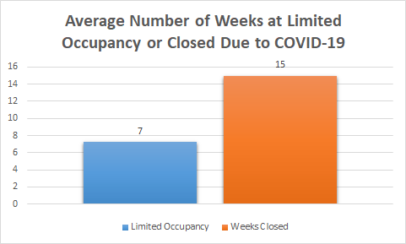
Pandemic Questions
*Derived from Question 77: number of weeks the main library on campus was closed due to COVID.
Notes:
Before we jump into some of our 2020 service data results, here is a quick look at the results of the two questions specific to accessing library facilities during the pandemic.
Question 78 asked about the number of weeks during the fiscal year that the library was closed when it otherwise would have been open. The main library was considered physically closed when faculty, students, and campus employees could not enter the building, regardless of access by library staff. Our preliminary data analysis suggests that over 80% of responding libraries indicated some period of time as closed with 15 weeks being the average number of weeks reported.
The survey also asked about the number of weeks that the library implemented limited occupancy practices for users, which were broadly defined as reduced hours, limits on number of users, appointment on
ly services, visitor time limits, room closures, etc. A preliminary look at this data suggests that 40% implemented limited occupancy practices for some period of time. We are asking these questions for the 2021 fiscal year as well.
Janine will now share some 2020 results with us.

Slide 9
2020 Data
Notes:
Let’s dive into some findings from the 2020 survey.

Slide 10
Mapping to the ACRL Standards
Institutional Effectiveness
Space
Collections
External Relations
Discovery
Educational Role
Professional Values
Administration
Personnel
Notes:
We wanted to present our latest findings in a way that would demonstrate how you can use the data to assess the contributions and impacts of your own libraries, so we matched up the data to The ACRL Standards for Libraries in Higher Education to look at library outcomes within the context of higher education priorities, similar to what the new Benchmark platform has to offer. The Standards identify performance indicators organized according to the nine principles on the slide. For the purposes of presenting the 2020 survey data, we are using them to evaluate the impact and state of libraries, sometimes by carnegie classification (doctoral, master’s, baccalaureate, and associate’s institutions) and other times looking at the state of libraries as a whole.

Slide 11
Educational Role
Library personnel collaborate with faculty and others regarding ways to incorporate library collections and services into effective curricular and co-curricular experiences for students.
Performance Indicator 3.1
Notes:
One of the performance indicators for the educational role standard is “library personnel collaborate with faculty and others regarding ways to incorporate library collections and services into effective curricular and co-curricular experiences for students.” We’ve paired data on group presentations as well as circulation and usage data with this performance indicator to show how libraries are collaborating with faculty as well as demonstrating the incorporation of library collections into experiences for students.

Slide 12
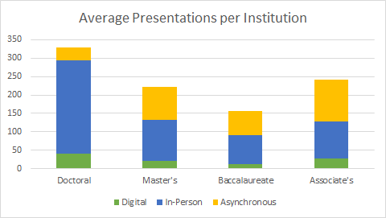
Notes:
In 2020, we collectively reached over 7 million users through over 375,000 presentations. This is quite the achievement especially given everything that has happened in the past year, everyone deserves a pat on the back. Now, let’s break this down to look at the average number of presentations at individual libraries and the modes in which they were delivered.
As Jeanette mentioned earlier, we introduced a new question on the 2020 survey that asks about asynchronous presentations in an attempt to capture this increasingly popular mode of presentations. We can see that although Doctoral institutions led in the average number of total presentations, associate’s institutions had the largest number of asynchronous presentations on average. Since this is the first year we inquired about the asynchronous presentations, this is representative only of the work done in 2020. It is possible, and quite likely, that some institutions have more asynchronous presentations developed prior to 2020. Data from this question on future surveys will help us understand the nature of this work and any trends that develop.

Slide 13
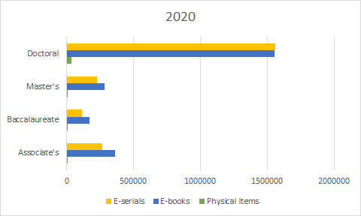
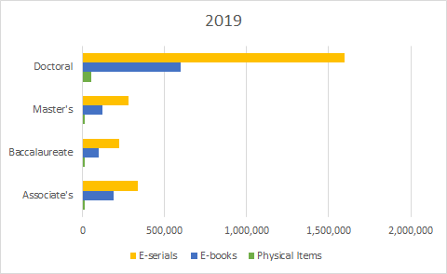
Average Circulation/Usage per Institution
Notes:
To measure how our collections are incorporated into curricular and co-curricular experiences for students, we can take a look at the average circulation and usage data for institutions. Given the state of the world in 2020, it may be no surprise to see that circulation of physical materials is down across all institutions from 2019 to 2020. What’s more interesting is that e-book usage skyrocketed for all institution types while e-serials usage decreased or remained stagnant. We can likely contribute the increase in ebook usage to the move to virtual learning at many institutions and the drive to purchase ebooks to replace texts on course reserve as well as the increased focus on purchasing materials in a format accessible to those off campus. It will be interesting to see with the 2021 survey data if this is a pandemic anomaly or if it is a trend that is here to stay. Either way, it demonstrates our profession’s responsiveness to the changing needs of faculty and students, both in and out of the classroom.

Slide 14
Discovery
The library provides one-on-one assistance through multiple platforms to help users find information.
Performance Indicator 4.6
Notes:
The discovery principle measures the work of libraries to enable discovery of information in all formats. Performance indicator 4.6 of the Discovery principle asks libraries to provide evidence that “the library provides one-on-one assistance through multiple platforms to help users find information.” ACRL data on reference transactions and consultations speak to this performance indicator.

Slide 15
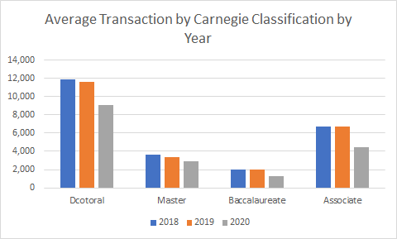
Notes:
Transactions are defined by the survey as interactions that involve the knowledge, use, recommendation, interpretation, or instruction in the use of one or more resources by a member of the library staff. Transaction data includes walk-ups at a service point and interactions conducted by phone, email, web, or other mediums. 2020 saw a sharp decline across all libraries types but the overall large number of recorded transactions suggests that there is still a need for information seeking assistance by skilled information specialists. Even as many libraries shut their doors in 2020, users still sought out our guidance.

Slide 16
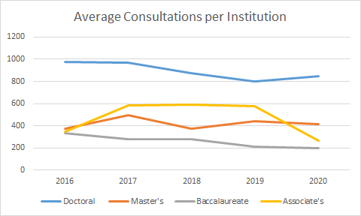
Notes:
Consultations are defined similar to reference transactions except that they are focused on one-on-one or small group appointments, are usually scheduled in advance, and occur somewhere other than the classroom or service point. On average over the past five years, the number of consultations at Master’s institutions remained fairly steady while those at baccalaureate institutions saw a slow decline. 2020 saw a sharper change for doctoral institutions with an increase in the average consultations from last year. Whereas Associate’s institutions had the largest change with a steep decline in the average number of consultations provided from 2019 to 2020. Further research is needed to determine whether this data reflects a trend or whether it is another anomaly of the pandemic.

Slide 17
Collections
The library builds and ensures access to unique materials, including digital collections.
Performance Indicator 5.3
Notes:
Performance Indicator 5.3 of the Collections standard addresses whether “the library builds and ensures access to unique materials, including digital collections.” To measure this indicator, we can look at the size and usage of academic libraries’ digital repositories.

Slide 18
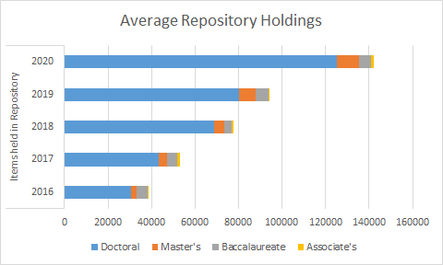
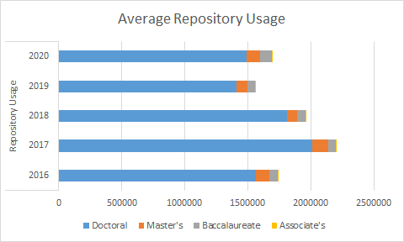
Items and Usage in Digital Repositories across All Libraries
Notes:
Over the past five years, the number of holdings in repositories have steadily increased with Doctoral institutions leading the charge. In 2020, doctoral institutions alone reported more than 41 million items in their repositories, followed by Master’s institutions at over 4 million items, baccalaureate with 1.4 million, and lastly, associate’s institutions with more than 300,000.
Not only where the holdings expanded but they were heavily used as well with close to 551 million total uses in 2020, an increase of almost 12% from last year. Again, doctoral institutions are the front runner, reporting close to 487 million uses. Over the past five years usage has remained somewhat consistent, showing that the work put into developing and expanding these digital and unique collections supports our users needs.

Slide 19
Management/
Adminstration/
Leadership
The library partners with multiple institutions (e.g., via collections consortia) to increase cost-effectiveness and to expand access to collections.
Performance Indicator 7.5
Notes:
Performance Indicator 7.5 of the management/administration/leadership standard measures how the library partners with multiple institutions, such as collections consortia, to increase cost-effectiveness and to expand access to collections. Data from the survey on contributions from consortia directly responds to this indicator.

Slide 20
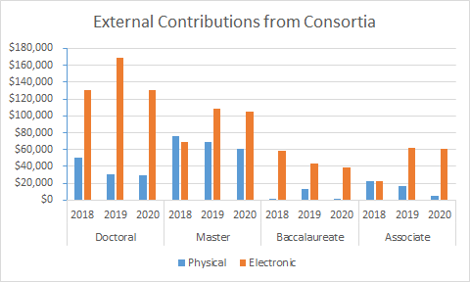
Notes:
Here we can see the average contribution of consortia per institution in each of the carnegie classes. The data represents contributions for both physical and electronic collections and shows how these have wavered over the past three years. The 2018 survey was the first to include this question, so we are only able to look at the past three years’ data. It is interesting to note that baccalaureate institutions have, on average, little contribution from consortia for physical materials. This is not a phenomena only experienced by these institutions, as it appears to be declining for all library types. This may be due to the emphasis on purchasing electric materials for our collections, but further research is needed on the relationship between libraries and consortia and their contributions to fully understand.

Slide 21
Personnel
Library personnel are sufficient in quantity to meet the diverse teaching and research needs of faculty and students.
Performance Indicator 8.1
Notes:
To measure the personnel standard, performance indicator 8.1 evaluates whether library personnel are sufficient in quantity to meet the diverse teaching and research needs of faculty and students. Determining whether the number of library personnel is sufficient to meet the needs of the users can be difficult, it begs the question “what is meant by sufficient”. We can interpret this to mean are the number of library personnel keeping up with the enrollment at our institutions. We can use survey data in different ways to look at this.

Slide 22
Student Full Time FTE to Total # of Staff FTE
 | 2016 | 2017 | 2018 | 2019 | 2020
Doctoral | 148:1 | 141:1 | 147:1 | 153:1 | 162:1
Master's | 187:1 | 190:1 | 194:1 | 211:1 | 208:1
Baccalaureate | 125:1 | 129:1 | 131:1 | 137:1 | 148:1
Associate's | 385:1 | 377:1 | 284:1 | 394:1 | 392:1
Notes:
One way to do this is to look at the ratio of student full time FTE to the total number of staff FTE. The total number of staff FTE represents all those who work in a library including librarians, other professional staff, non-professional staff, and student workers, but not including maintenance or facilities staff. We can see that on average, the number of student FTE per staff member fluctuates over the past five years for the most part, but shows that for baccalaureate and doctoral institutions, the number of students per library staff are steadily increasing. There are a number of factors that could be at play here, so let’s take a different look at the data.

Slide 23
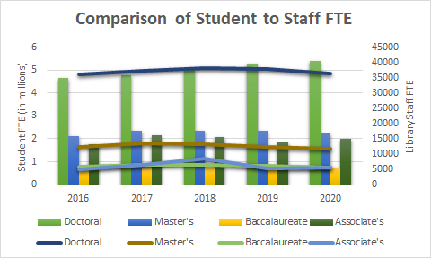
Notes:
This chart shows the total enrollment over the past five years as well as the total number of library staff FTE by carnegie class. Thinking about the ratio data that we just looked at, let’s take a closer look at what is happening with doctoral institutions. In the previous slide we saw that the number of student FTE per library staff number has increased steadily over the last five years. While this could be caused by a decrease in the number of library staff, we can see in this chart that while library staffing has largely remained the same over the past five years at doctoral institutions, their enrollment has increased. This could be justification for increasing the number of library staff to sufficiently meet the needs of faculty and students at those institutions. While this data is representative of all libraries collectively, one could use the ratios or student FTE and Staff FTE data to measure how their own institutions compare against peers in the number of library staff they have to serve their populations. Devin will talk more about ways to benchmark using the survey data later in this presentation. I will now turn it over to Jeannette to talk about the trends questions.

Slide 24
Trends Questions

Slide 25
Recent Trends Topics
2020 - Equity, Diversity, and Inclusion (EDI)
2019 - Open Educational Resources (OER)
2018 - Library Contributions to Student Success Initiatives
2017 - Faculty Rank, Status, and Tenure for Librarians
2016 - Staffing & Services
2015 - Collections
Notes:
Thank you Janine.
We will now take a look at the 2020 Trends question responses. While most of the survey questions remain the same each year, the Trends section offers an opportunity to gather additional data on a selected topic. The Editorial Board discusses survey feedback and looks at current trends in the profession to determine a topic for the trends questions each year. The board then develops a set of questions, often seeking input from relevant ACRL Committees or the ACRL Board of Directors. Trends questions are designed to have a low burden of response, meaning they are designed to be easily answered by an informed respondent without additional information gathering.
This slide shares some of the trends topics from recent years. For 2021, we are developing a set of trends questions on instructional and outreach activities, including asynchronous instructional work.

Slide 26
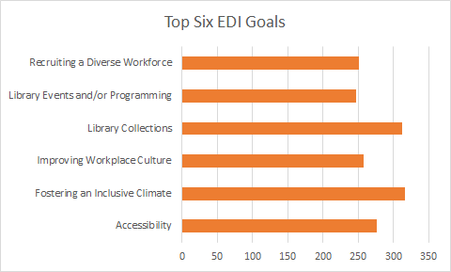
2020 Trends Findings
Notes:
For the 2020 Survey, the Trends questions focused on what types of activities libraries are doing in support of Equity, Diversity, and Inclusion or EDI, which is an important strategic priority for ACRL and ALA, as well as many of our campuses. Our preliminary look at the results suggest that around 27% of the 352 libraries completing this part of the survey have formal, written goals for EDI, with the number for doctoral institutions being close to 50%.
For those libraries with written goals, we were able to ask about the types of goals included. The top six focus areas for goals were:
Fostering an inclusive climate (89.7%)
Library collections (88.6%)
Accessibility (78.9%)
Improving workplace culture (73.2%)
Recruiting a diverse workforce (71.2%)
Library events and/or programming (70.1%)

Slide 27
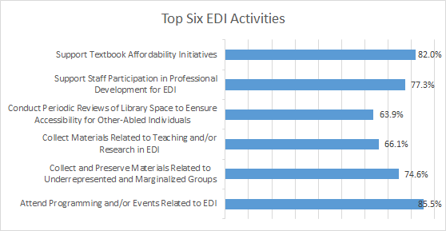
2020 Trends Findings
Notes:
The survey also looked at what types of activities academic libraries are doing in support of EDI, whether or not they have written goals. The question asked was “Does your library do (or has it done) any of the following? The top six responses to this question were:
Attend programming and/or events related to EDI
Support textbook affordability initiatives
Support staff participation in professional development for EDI, and
Collect and preserve materials related to underrepresented or marginalized groups
Collect materials related to teaching and/or research in EDI
Conduct periodic review of library space to ensure accessibility for other-abled individuals
It is really wonderful to see so much support for EDI across all types of academic libraries.

Slide 28
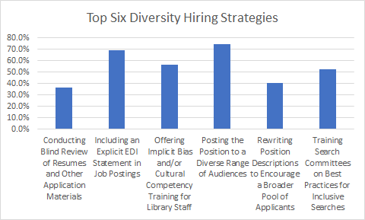
2020 Trends Findings
Notes:
The next two trends questions looked at hiring and retention practices. Question 3.1 asked what strategies libraries are using to hire staff from underrepresented groups. The top six strategies were posting the position to a diverse range of audiences; including an explicit EDI statement in the position description; and offering implicit bias and/or cultural competency training to library staff; training search committees on best practices for inclusive searches; rewriting position descriptions, and conducting blind review of resumes and application materials.

Slide 29
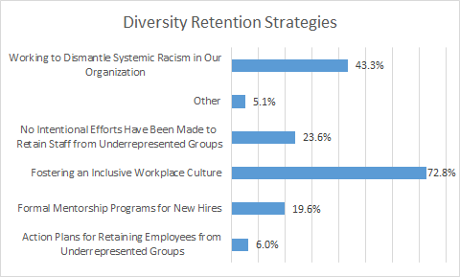
2020 Trends Findings
Notes:
In regards to strategies for retaining staff, there was a clear top two strategies: fostering an inclusive workplace culture and working to dismantle systemic racism in our organization.
Next we are going to hear from Devin Savage about how you can use ACRL data for peer comparisons.

Slide 30
Benchmarking using the Data
Notes:
Why might you need to benchmark - consultants came in with idea that we were over-staffed.

Slide 31
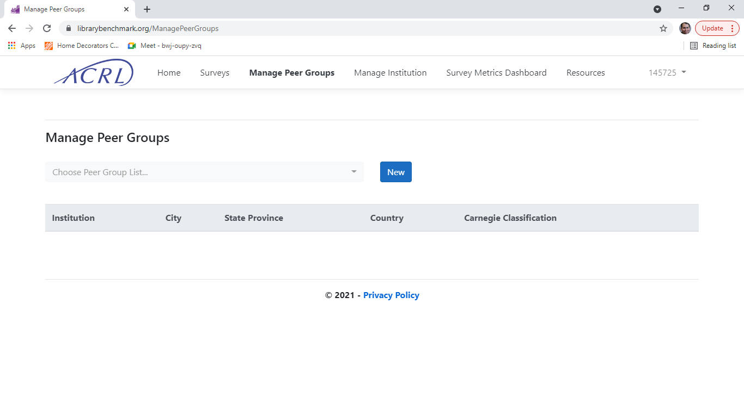
Benchmarking Example
Choose Period, Name, Description, Locations, and Indicators
Indicators are data entered (expenditures, holdings, services, etc.)
Locations are the individual institutions that you can compare your results against - but not all institutions submit

Slide 32
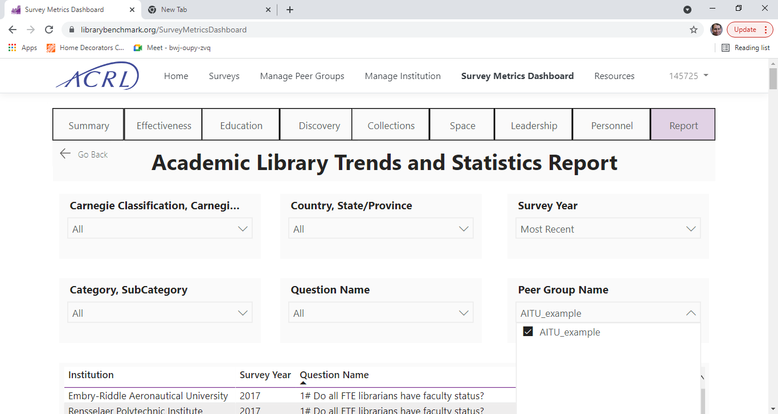
Benchmarking Example
IIT vs AITU
Salary +3.7%
Materials -13.3%
Presentations +15.9%
Gate Count* +15.7%
Notes:
small additional amount of personnel - more presentations, programming, higher gate count > higher student engagement
8 schools chosen but only 5 available

Slide 33
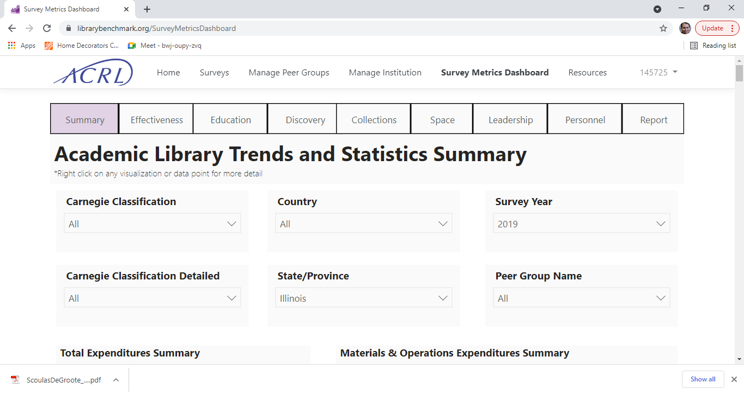
Statewide comparison
Notes:
State, FY19

Slide 34
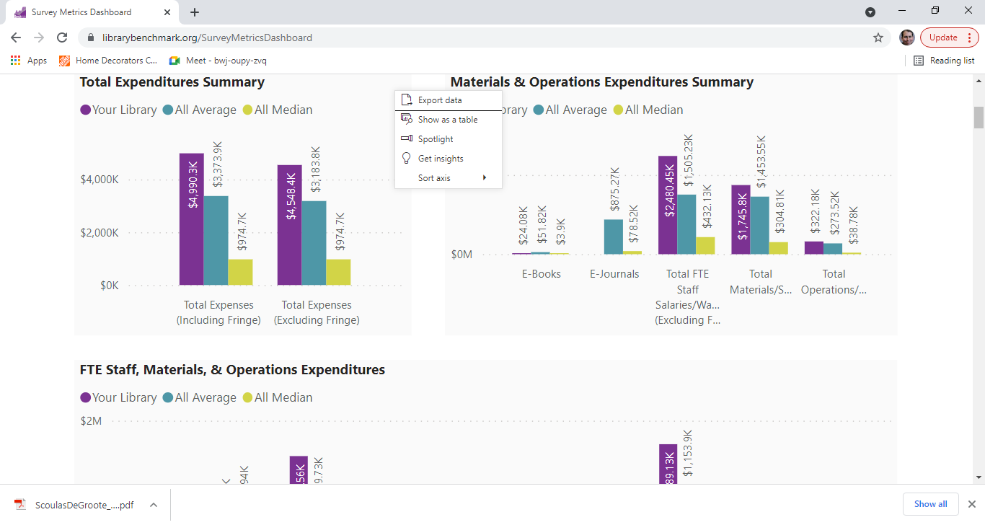
Look for outliers, choose fields, export data!

Slide 35
Accessing the Data

Slide 36
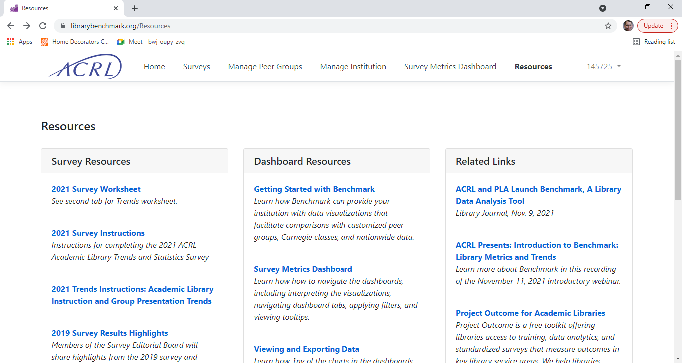
Notes:
As mentioned earlier, ACRL works to provide subscription access to all ACRL survey data from 1998-present. Survey participants receive a link to the summary results by Carnegie Classification within a few months of the survey closing date. These are the aggregated library data reports from the 2020 ACRL Academic Library Trends and Statistics survey. Reports are grouped by Carnegie classification for effective benchmarking. Each numbered item within the reports corresponds to a question on the ACRL survey and Trends Questions. In addition, ACRL publishes a print edition of the complete results which is available through the ALA Online Store. Custom reports are available to subscribers. For more info and pricing you can visit acrlbenchmark.com

Slide 37
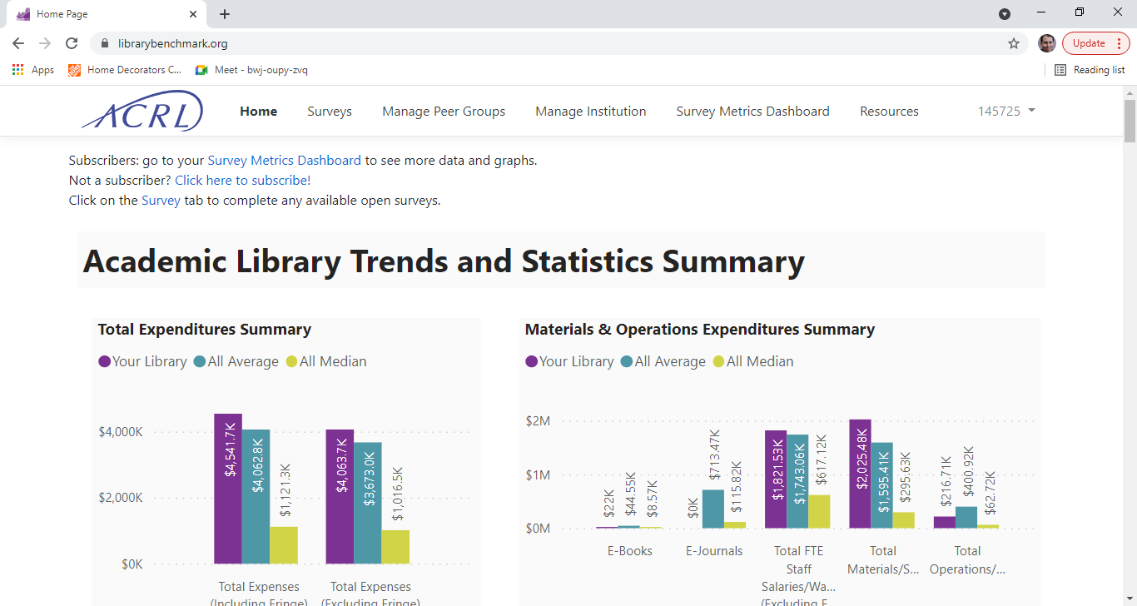

Slide 38
Correcting 2020/historical data
Yes, it’s possible!
acrlbenchmark@ala.org
Notes:
Thanks to Mary Jane Petrowski and Gena Parsons-Diamond

Slide 39
Editorial Board

Slide 40
What we do?
Review/refine questions and guidance
Create and define Trends questions
Identify non-respondents and reach out to encourage greater participation
Liaise with appropriate groups
Provide rapid-response assistance
Notes:
New questions, confusing issues and 4. IPEDS, Project Outcome, ACRL Pubs,

Slide 41
Recent Common Questions
Virtual Reference (#67) vs Reference Transactions (#64)
Electronic Usage/Circulation (#60-#63)
Asynchronous Presentations (#72)
Virtual reference (67) = online reference transactions + online Research Consultations whereas Reference transactions (64) = in-person + online transactions (but not consultations!)
For eJournal usage, use “Unique Item Requests” and for ebooks use “Total Item requests”
We will continue to ask this question, please try to capture the work put forth by the library
Notes:
Guidance will likely change on these

Slide 42
Contact Us
acrlbenchmark@ala.org
Janine A Kuntz kuntz_janine@wheatoncollege.edu
Jeannette Pierce, Vice-Chair piercejea@missouri.edu
Devin Savage, Chair dsavage@iit.edu

Slide 43
Questions?
Notes:
Please type into the chat if you have participated in the survey, or if you have not - and if not, why not?

Slide 44
More Information
.
ACRL Benchmark: https://librarybenchmark.org/
Survey Information: https://acrl.libguides.com/stats/surveyhelp
Kuntz, Janine A.; Pierce, Jeannette E.. The 2019 ACRL Academic Library Trends and Statistics Annual Survey: Mapping results to the ACRL Standards for Libraries in Higher Education. College & Research Libraries News, [S.l.], v. 82, n. 2, p. 87, feb. 2021. ISSN 2150-6698. Available at: <https://crln.acrl.org/index.php/crlnews/article/view/24814/32643>. Date accessed: 14 june 2021. doi:https://doi.org/10.5860/crln.82.2.87.
This work is licensed under a Creative Commons Attribution 4.0 International License

